Slide 1
Simple vs. Complex Pricing
Module 6 · Video 2
Management 405
Prof. Nico Voigtländer · UCLA Anderson

Slide 2
Module 6 · Video 2 · Agenda
Outline of Module 6
1
Simple vs. Complex Pricing
The pricing dilemma and why complex pricing pays
Video 2
2
Direct Price Discrimination
Videos 3+4
2a
Perfect Price Discrimination (First Degree)
Video 3
2b
Segment Pricing (Third Degree)
Video 4
3
Indirect Price Discrimination (Second Degree)
Video 5
4
Advanced Pricing Strategies
Videos 6–8
4a
Flat Fee Pricing
Video 6
4b
Two-Part Tariff
Video 7
4c
Block Pricing
Video 8
5
Summary of Pricing Strategies
Video 9
Management 405 · Module 6 · Complex Pricing and Advanced Pricing Strategies
2
Notes:
We begin with the pricing dilemma itself: what exactly goes wrong when a firm with market power charges everybody the same price.

Slide 3
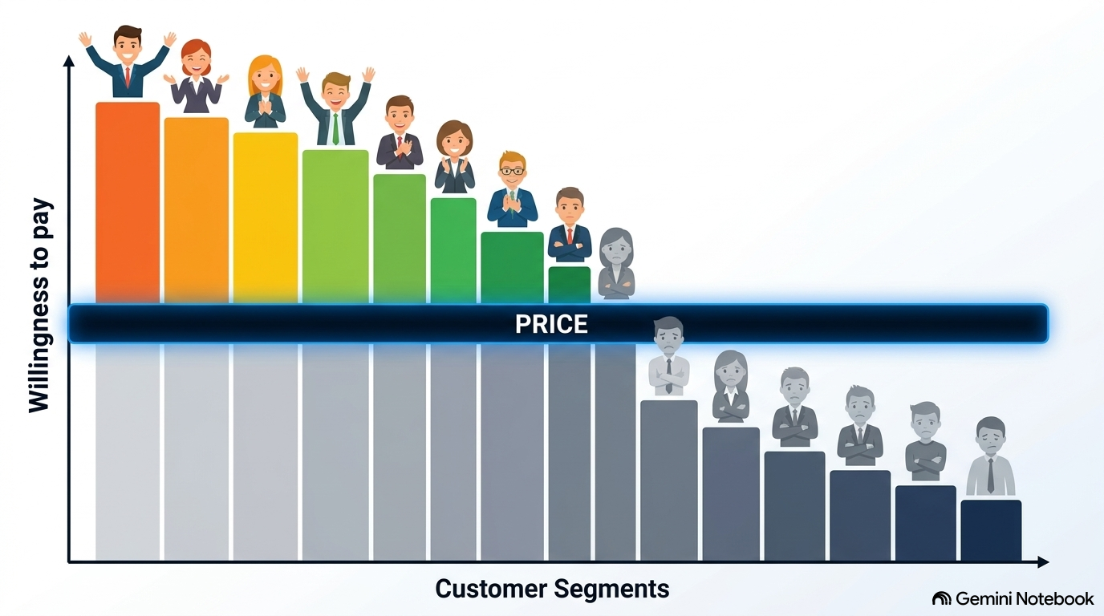
Module 6 · Video 2 · Simple vs. Complex Pricing
Dilemma of Simple Pricing
Simple pricing: same price for all customers
Limitations of simple pricing:
  If you charge a low price, you are too “generous” to those with high willingness to pay
  If you charge a high price, you prevent customers with relatively low willingness to pay (marginal personal value) from purchasing your product
Under Simple Pricing, your price is ‘too low’ for some, and ‘too high’ for others
Management 405 · Module 6 · Complex Pricing and Advanced Pricing Strategies
3
Notes:
This is the trap. Charge a high price and you capture a lot from each buyer, but you lose everyone whose willingness to pay sits below it. Charge a low price and you sell to almost everyone, but you hand a large surplus to the customers who would happily have paid far more. One price cannot do both jobs, and that is the problem the rest of the module solves.

Slide 4


Module 6 · Video 2 · Simple vs. Complex Pricing
What if Netflix Used Simple Pricing per Movie? (Assume MC = 0)
P
$4
$$P = 4 − \frac{Q}{3}$$
$2
Max. possible TR under simple pricing = $12
D
Since MC = 0: profit maximization implies MR = MC = 0, so Netflix charges $2 per movie.
MC = 0
6
12
Movies per month
MR
Management 405 · Module 6 · Complex Pricing and Advanced Pricing Strategies
4
Notes:
Let us put numbers on it. Demand is P equals 4 minus Q over 3, and marginal cost is zero, so profit maximization means setting marginal revenue to zero. That happens at 6 movies and a price of two dollars, which brings in twelve dollars a month. Hold on to that twelve dollars, because we will beat it several times before the module is over.

Slide 5

Module 6 · Video 2 · Simple vs. Complex Pricing
One Price Leaves Two Kinds of Money on the Table
P
$4
$$P = 4 − \frac{Q}{3}$$
Simplifying assumption: MC = 0
Revenues under Simple Pricing
“Wasted profits”: consumer surplus + unexploited markets
Consumer surplus
$2
Potential profits under complex pricing
Revenues
Unexploited
markets
D
6
12
Movies per month
Management 405 · Module 6 · Complex Pricing and Advanced Pricing Strategies
5
Notes:
Now look at what that twelve dollars leaves behind. The red triangle above the price is consumer surplus, value the customer keeps. The grey triangle to the right is the unexploited market, viewers who would have watched at some positive price and were shut out. Neither of those is a cost of doing business; both are money the one-price strategy simply fails to reach.

Slide 6

Module 6 · Video 2 · Simple vs. Complex Pricing
Complex (Non-Uniform) Pricing
Requirements for complex pricing:
  Market power
    Downward-sloping demand (i.e., price searcher)
    Market power → price searchers have pricing power
  Capacity to prevent resale and arbitrage
  Enables sellers to charge different prices for different volumes/packages, or to different customers
Complex pricing is usually more profitable than simple pricing
Management 405 · Module 6 · Complex Pricing and Advanced Pricing Strategies
6
Notes:
Consumers are better off under resale: low-price consumers can resell their purchases at a profit; high-price consumers can buy product at a lower price than the firm would charge
Firms are not better off, since only selling at one price, the lower price!

Slide 7
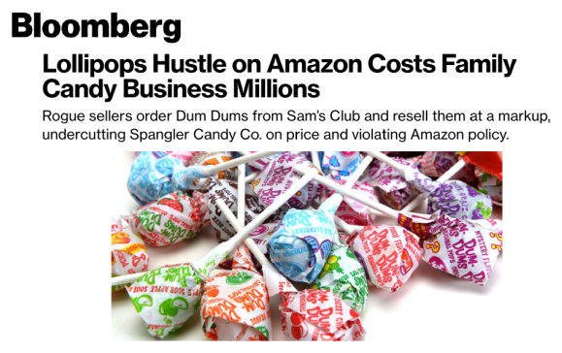
Module 6 · Video 2 · Simple vs. Complex Pricing
Preventing Resale: The Dum-Dums Case
Dum Dums sold in bulk at half the price on Sam’s Club
Resellers never held any stock
They listed Dum-Dums on Amazon, waited for an order, then had Sam's Club ship it straight to the Amazon buyer
If buyers can resell, complex pricing is ineffective
Management 405 · Module 6 · Complex Pricing and Advanced Pricing Strategies
7
Notes:
Spangler Candy is a family business, and it makes Dum-Dums. Bloomberg's story is the clipping on the slide: rogue sellers buy Dum-Dums at Sam's Club, list them on Amazon at a markup, and undercut Spangler's own price while doing it. The headline puts what that costs the company in the millions.
Note: Sam's Club is an American chain of membership-only retail warehouse clubs owned and operated by Walmart Inc.. Founded in 1983 by Walmart creator Sam Walton, it sells groceries, electronics, and household goods in bulk quantities at deeply discounted prices.
The resellers never held any stock. They listed Dum-Dums on Amazon, waited for an order, then bought one 500-pack at Sam's Club and had Sam's Club ship it straight to the Amazon buyer. The source is Bloomberg's story by Spencer Soper (August 2, 2022). It is paywalled, so everything below comes from syndicated and secondary write-ups of it, and I have not read the original.
Notice what those sellers are adding: nothing. They are not manufacturing, branding or improving anything. They are moving the same candy out of a cheap channel into an expensive one and keeping the spread. That is arbitrage, and it exists only because the identical product is available at two prices.
Two things make it hard to stop. Listing on Amazon costs a seller essentially nothing, so one person who spots the gap can scale to a thousand listings with no fixed cost to recover, and the arbitrage does not stay small. And Bloomberg notes that the sellers are violating Amazon's policy, which is the part worth dwelling on: an explicit contractual ban did not stop it, because policing thousands of third-party listings is much harder than writing the rule.
The general lesson is the one in the blue bar. A firm can have all the market power in the world, but if the customer who is offered the low price can turn round and sell to the customer who was offered the high one, the two prices collapse into one. Ask the class what Spangler could actually do about it: different pack sizes or different products for different channels, contracts with distributors, tighter allocation to the clubs, or simply a smaller gap between the two prices. Every one of those is a way of making resale hard, which is the condition this slide is here to establish.
Source: Bloomberg.

Slide 8
Module 6 · Video 2 · Simple vs. Complex Pricing
Three Degrees of Price Discrimination
First degree (direct): “Dream world”: the firm knows each customer’s willingness to pay (marginal personal value – MPV)
Third degree (direct): The firm can identify specific groups of customers with different MPV (students, seniors, tourists)
Second degree (“indirect”): The firm cannot identify customers’ MPV, so it uses different purchase options to infer willingness to pay: versioning, quantity discounts, coupons
Management 405 · Module 6 · Complex Pricing and Advanced Pricing Strategies
8
Notes:
The three degrees are really three answers to one question: how much does the firm know about who is standing in front of it? First degree, it knows each customer's willingness to pay. Third degree, it can sort people into groups. Second degree, it knows nothing and has to design choices that make customers sort themselves. Everything in this module is one of those three.

